Slide 1

Empowering Access to Justice in Rural Kenya
HAKI KENYA
Micro-Justice & Legal Aid Platform for All
Bridging Legal Gaps with Technology and Community
PATRICIA NDUKU MUGISIA | ndukupatricia136@gmail.com | 4/7/2025

Slide 2
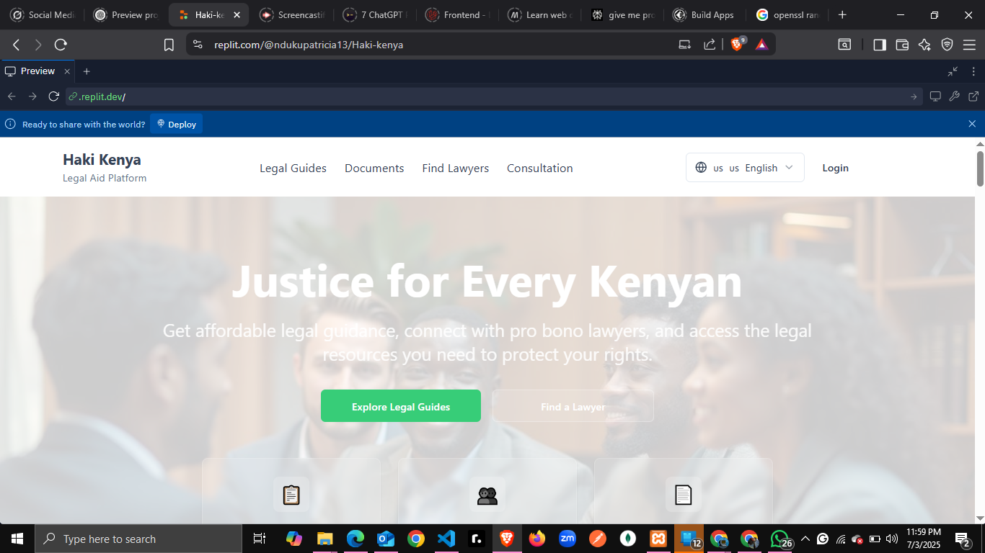

Slide 3

Justice Denied: The Rural Legal Crisis in Kenya
Over 70% of rural Kenyans lack affordable legal aid due to distance, cost, and lack of awareness.
The Legal Aid Act (2016) aimed to improve access, but implementation gaps remain.
Many Kenyans face systemic barriers, with poverty levels above 36% and high case backlogs.
Legal fees range from Ksh. 15,000 to over Ksh. 500,000, unaffordable for most rural households.

Slide 4
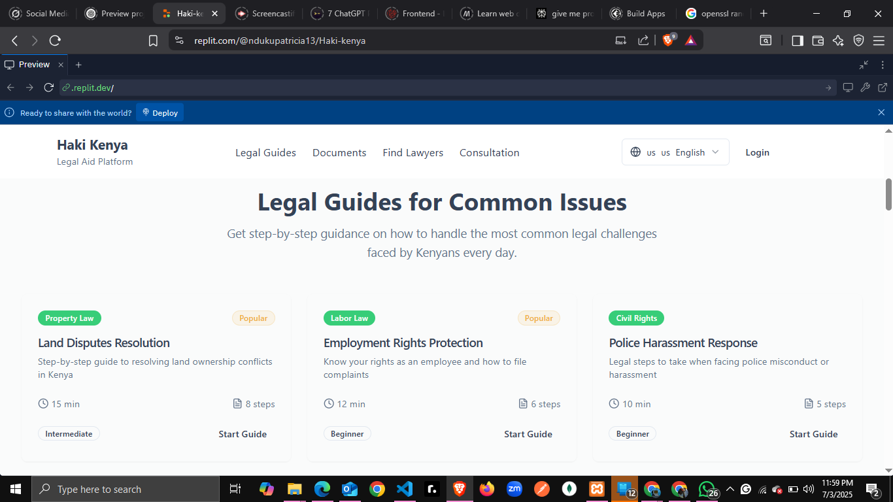

Slide 5




Our Solution: Affordable Legal Aid for Rural Kenya
We propose a transformative solution to bridge the critical legal aid gap in rural Kenya, leveraging accessible technology and community-centric design.
Mobile-First Platform
Offline & USSD Access
Offering legal guides, anonymous reporting, lawyer consultations, and document templates directly on smartphones.
Ensuring reach in areas with limited internet connectivity, maximizing inclusivity.
Affordable Justice
Empowering 15 Million
Average legal aid cost on our platform is Ksh. 8,000/year, making justice accessible to all.
Underserved rural Kenyans will gain access to vital legal support, fostering self-reliance and justice.

Slide 6
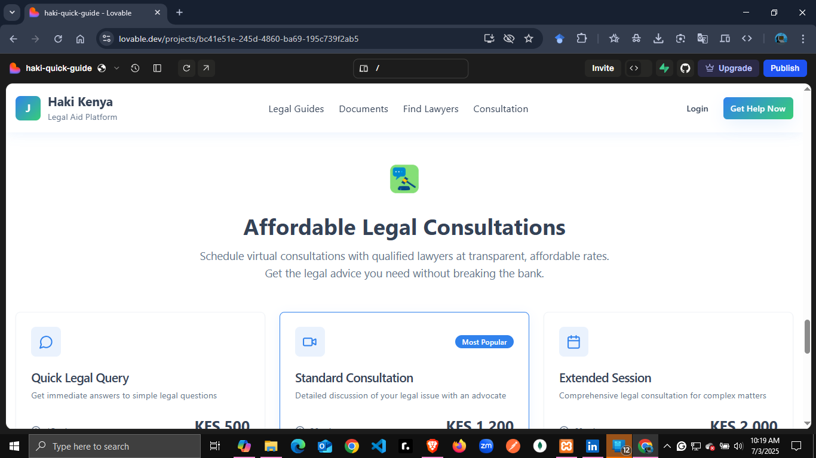

Slide 7
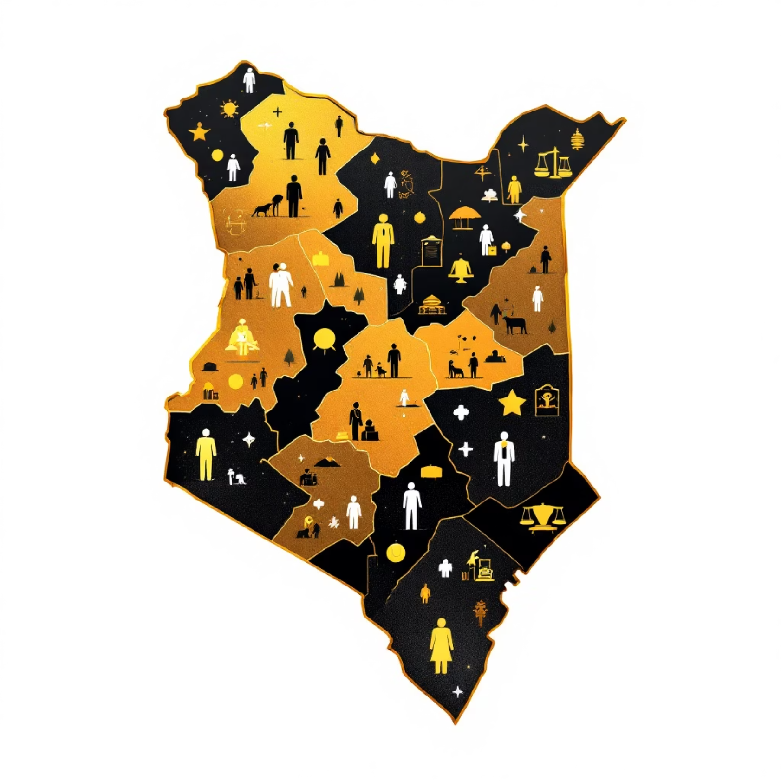
Target Market: Rural Communities & Legal Practitioners
Our primary focus is on the 15 million rural Kenyans residing in underserved counties who currently lack access to affordable legal services. This includes:
Low-income households
Marginalized groups
Individuals facing everyday legal challenges
Additionally, we aim to serve 10,000 lawyers and paralegals seeking efficient tools to expand their reach and impact in these communities.

Slide 8
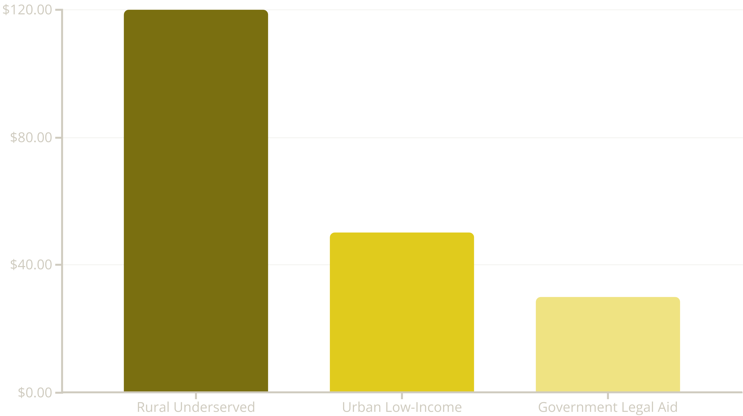
Market Opportunity: Ksh. 120 Billion Legal Aid Sector in Kenya
Kenya's legal aid sector presents a significant, untapped opportunity, driven by a large underserved population and growing policy support.
With approximately 50 million Kenyans in 2025, around 30% (15 million) reside in rural areas with limited legal aid. An estimated average annual spend of Ksh. 8,000 per user creates an addressable market of Ksh. 120 billion. This growth is further fueled by supportive government policies and NGO initiatives.

Slide 9
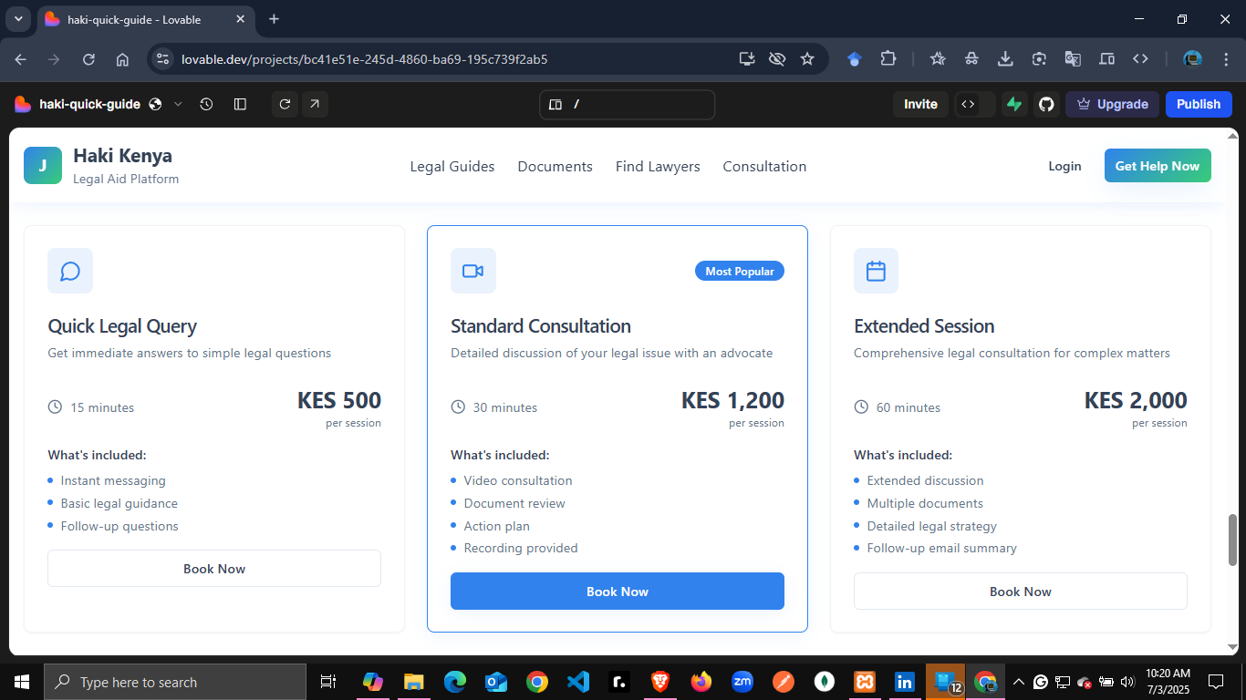

Slide 10
Competitive Landscape
While existing players offer some legal support, our platform uniquely addresses critical gaps in the market, particularly for rural communities.
Rural Reach
❌ Limited
❌ Limited
✅ Extensive
Offline Access
❌ No
❌ No
✅ Yes (USSD)
Cost-Effectiveness
❌ High
✅ Moderate
✅ Very High
Community Integration
✅ Local
❌ Low
✅ Deep
Comprehensive Services
✅ Yes
✅ Partial
✅ Full Suite

Slide 11
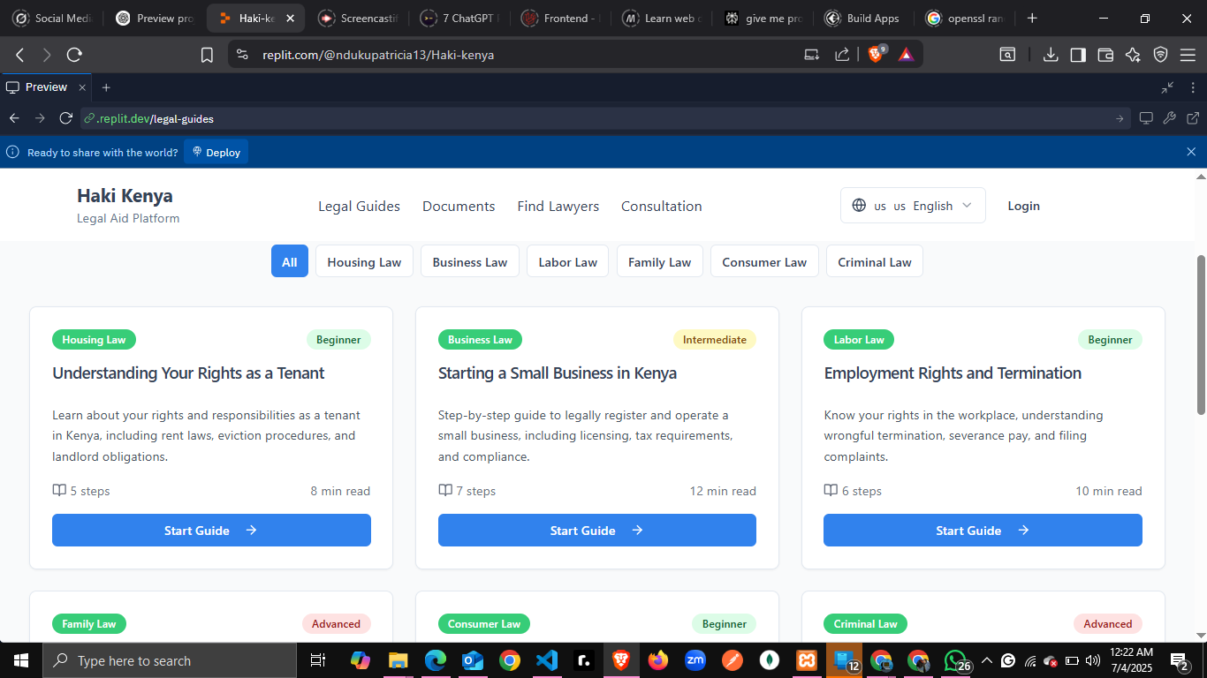

Slide 12



Why We Stand Out
Our innovative approach focuses on three core pillars that set us apart from the competition, ensuring sustainable impact and widespread adoption.
Offline-First Design
Unmatched Affordability
Strong Partnerships & Scalability
Ensuring access even in remote areas with limited or no internet connectivity, leveraging USSD for maximum reach.
Legal aid at Ksh. 8,000/year, significantly lower than traditional fees of Ksh. 15,000 and above, making justice accessible to all income levels.
Building robust community partnerships and designing a model that is inherently scalable across Kenya and beyond.

Slide 13
Progress & Future Plans
We have achieved significant milestones and have a clear roadmap for expansion, ensuring sustainable growth and wider impact.
Current Progress
Q1 2026
Pilot success with 300 users and strong partnerships with 3 counties established.
Scale-Up: Expand user base to 50,000, solidifying market presence and refining services.
1
2
3
4
Q3 2025
2027 Onwards
MVP Launch: Roll out Minimum Viable Product with core features to initial target users.
Regional Expansion: Begin phased expansion into neighboring East African countries.

